Slide 1
Movie Recommendation System
Md. Baker, 1911672642
Kazi Kaarima Nashia,2031176642
Fatema Akter Rimi, 2021930042

Slide 2
The need for recommendation system
Users face abundant options when they engage in Internet
To help them in making choice, recommendation systems come to suggest items to the users that are interesting to them

Slide 3
Types of recommendation systems
Content based filtering
Collaborative based filtering
Hybrid based filtering

Slide 4
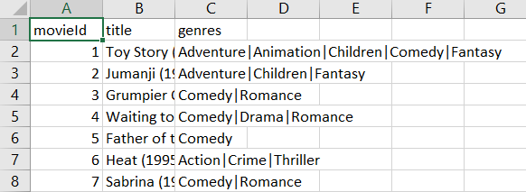
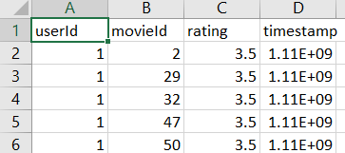
Lets first look at our dataset
Movies
Ratings

Slide 5
Content based filtering
An algorithm that will give recommendations to a user based on the items that they have liked in the past
Hence, it uses features of the items in order to make recommendations
In our dataset, the feature of the movie is genre
At first, we have to use TF-IDF to convert text into vectors
Then develop a vector space model to represent the vectors in vector space
After this, use cosine similarity to find similar movies

Slide 6
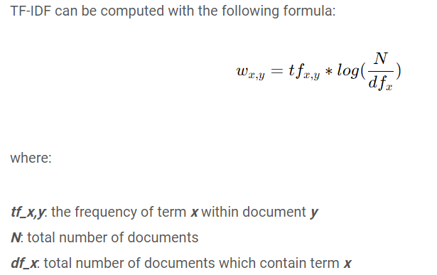
TF-IDF
TF is Term Frequency which will count average number of times a word has appeared. In our case, genre will be counted
IDF- will measure the proportion of movies that contain that particular word/genre

Slide 7
Vector Space Model
In this model, the text or vectors are represented in vector space
Can use these vectors to calculate the similarity between words( in our case, genre)

Slide 8
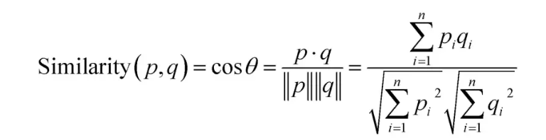
Cosine similarity to find similar movies
Users will be similar if the value of cos theta is close to 1

Slide 9
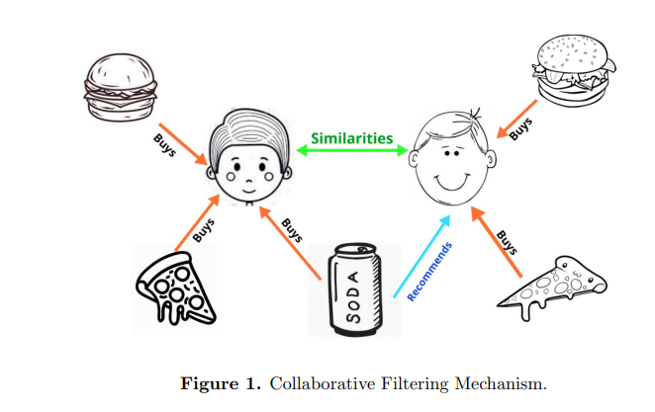
Collaborative Filtering
1. A system that recommend items to users based on the preferences of other users
3. After this, it looks at the items they like and combines them to create a ranked list of suggestions.
2. Works by searching a large group of people and finding a smaller set of users with tastes similar to a particular user.

Slide 10
How does the system make recommendations?
Users will be similar if they give similar ratings to an item
To capture this rating, a user-item matrix is used
Using this matrix:
similarity between users/item is calculated
rating is calculated on an item
If the ratings are good, then recommendations are provided

Slide 11
User-item matrix
 | movieId2 | movieId260 | movieId1214 | movieId1970
User 1 | 3.5 | 4 | - | 4
User 2 | - | 5 | 5 | 5
User 3 | - | 5 | - | 5
The values in the matrix represents the ratings a user would give to a movie

Slide 12
Finding similarity between users based on the ratings
Cosine similarity

Slide 13
Lets start looking at the similarity

Slide 14
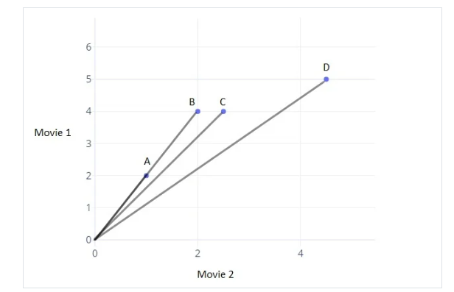
Cosine similarity
For simplicity, only 2 movies are taken in this example and they are plotted on x and y axis.
Point B(2,4) means that user B has given 2 ratings to movie 2 and 4 ratings to movie 1.
To find similarity between user B and user C, cosine similarity is used to measure the angle between them.
Users will be similar if the value of cos theta is close to 1

Slide 15
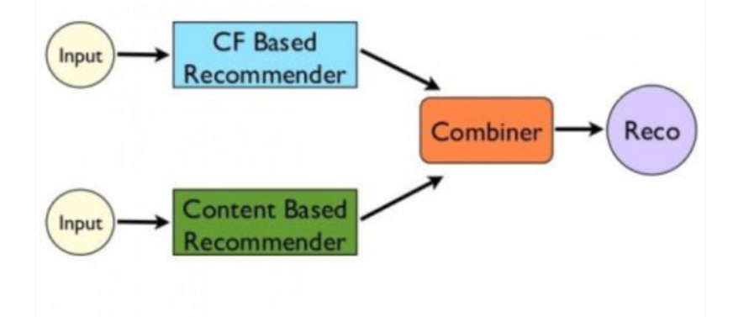
Hybrid based filtering system
It is a system of two or more recommendation systems that work together to provide accurate and diverse recommendations
Mostly, content based and collaborative filtering is used
Both content and collaborative systems receive datasets that are different
Then the output of both the recommender system is joined to make a hybrid system

Slide 16
Thank You

